Slide 1
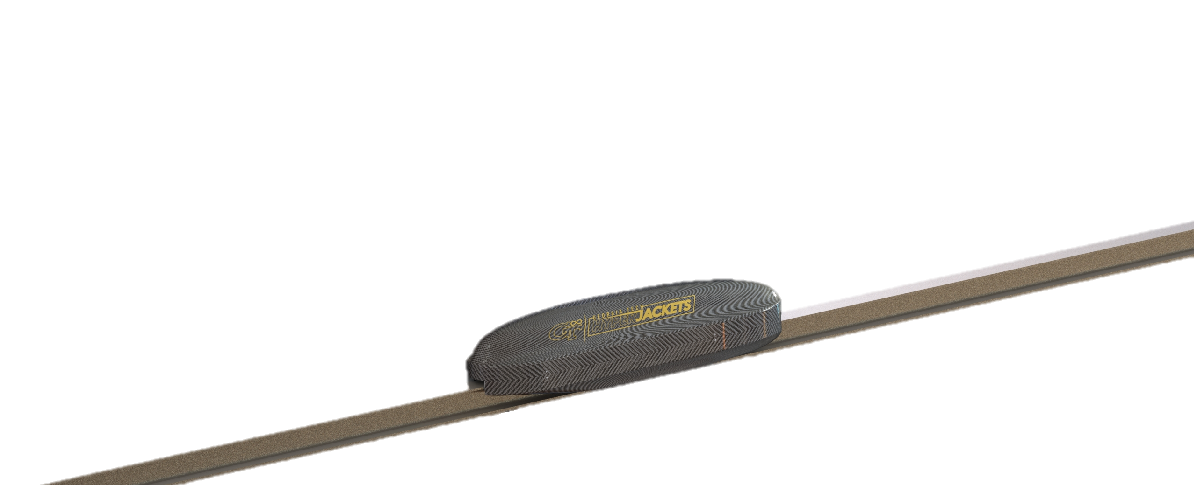
GT HyperJackets Preliminary Design Brief
2019 SpaceX Pod Competition

Slide 2
Team Structure and Organization
Faculty Advisors
President
Vehicle Dynamics Lead
Aerostructures Lead
Electronics Lead
Secretary
Treasurer
Propulsion
Braking
Stability
Chassis
Aeroshell
Battery
Software
Materials
PCB Hardware
PCB Firmware
Interconnects
40+ Undergraduate and Graduate Students
Students from Mechanical Engineering, Aerospace Engineering, Computer Science, Computer Engineering, and Electrical Engineering Majors

Slide 3
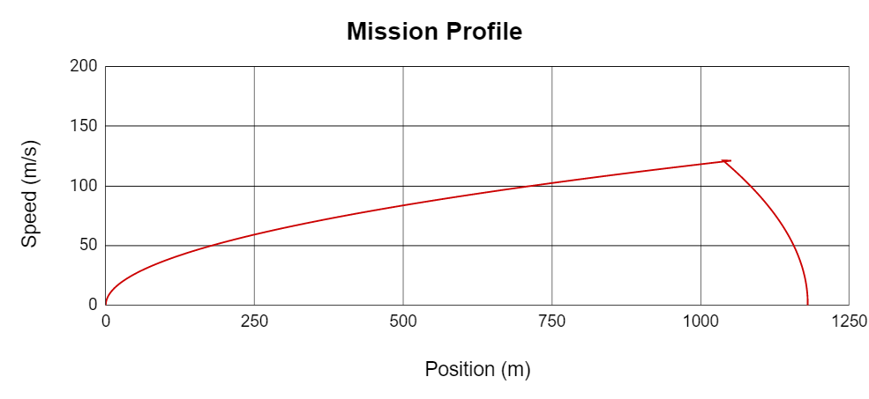
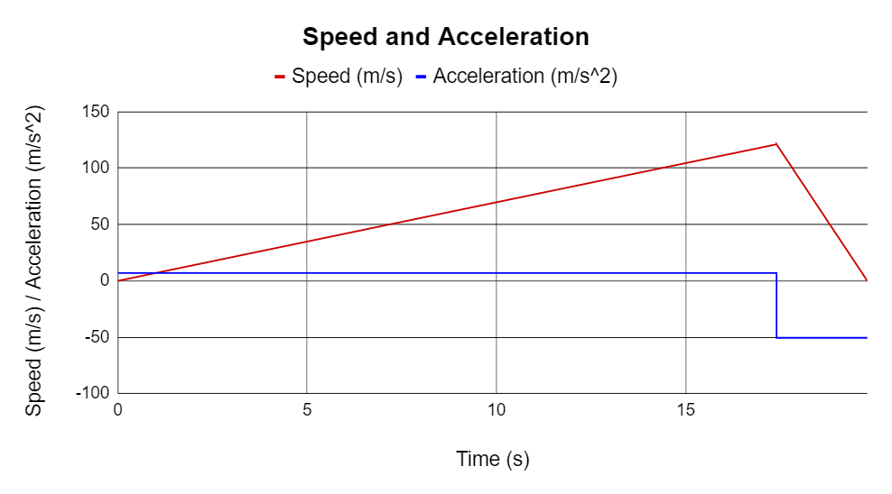
Pod Overview
Max Velocity: 121 m/s
Max Acceleration: 0.71 g
Max Deceleration: 5 g
Total Power Consumption (Peak): 92 kW
Pod Position at End of Run: 1180 m
Pod Dimensions: 1.7m x 0.38m x 0.38m
Pod Mass: 100.2 kg
System | Mass (kg)
Aerostructures | 10.3
Stability | 2.5
Braking/Pneumatics | 7.9
Propulsion | 26.7
Electronics | 10.8
Power | 42
Total Mass | 100.2 kg

Slide 4
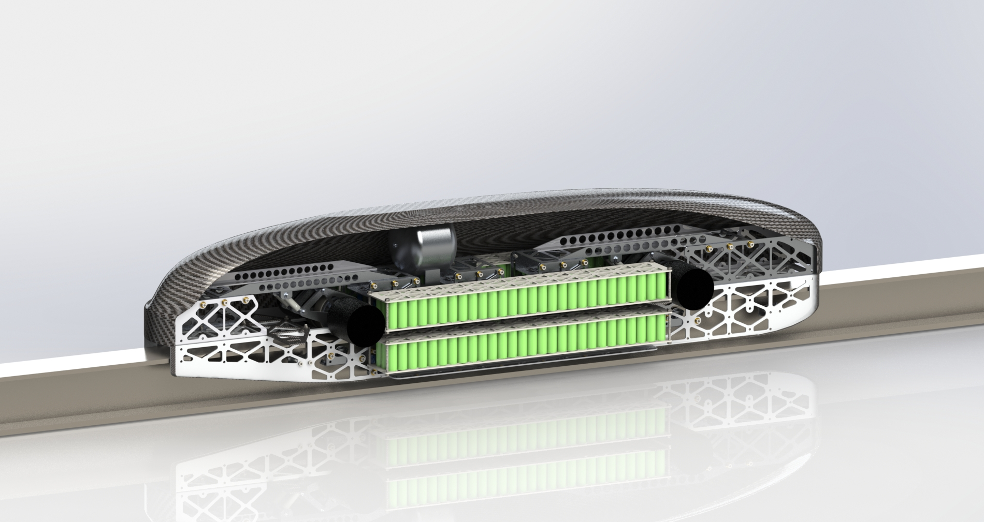
POD Overview
Air Tank
Battery Module
Vertical Stability

Slide 5
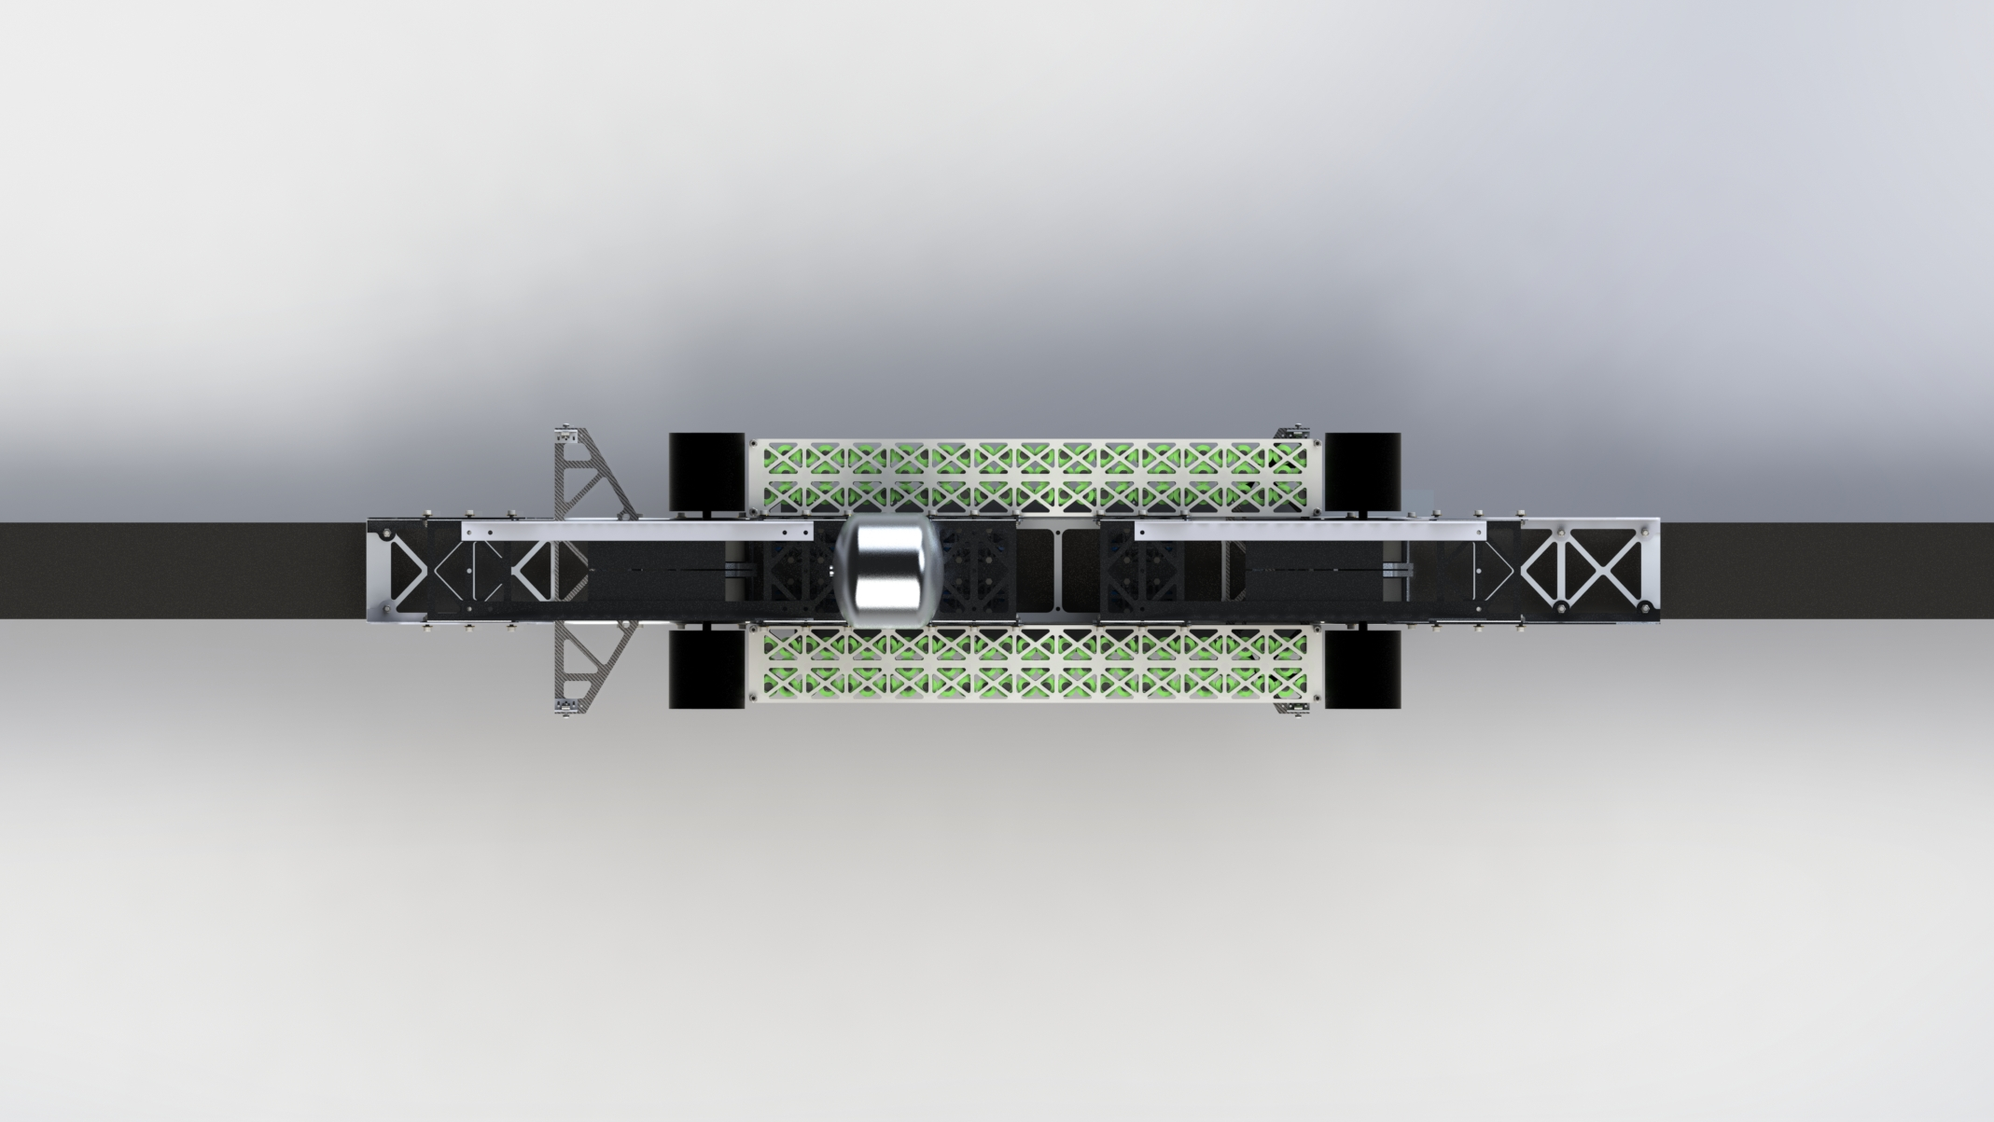
POD Overview
Brakes
Aeroshell Mounts
Motors

Slide 6
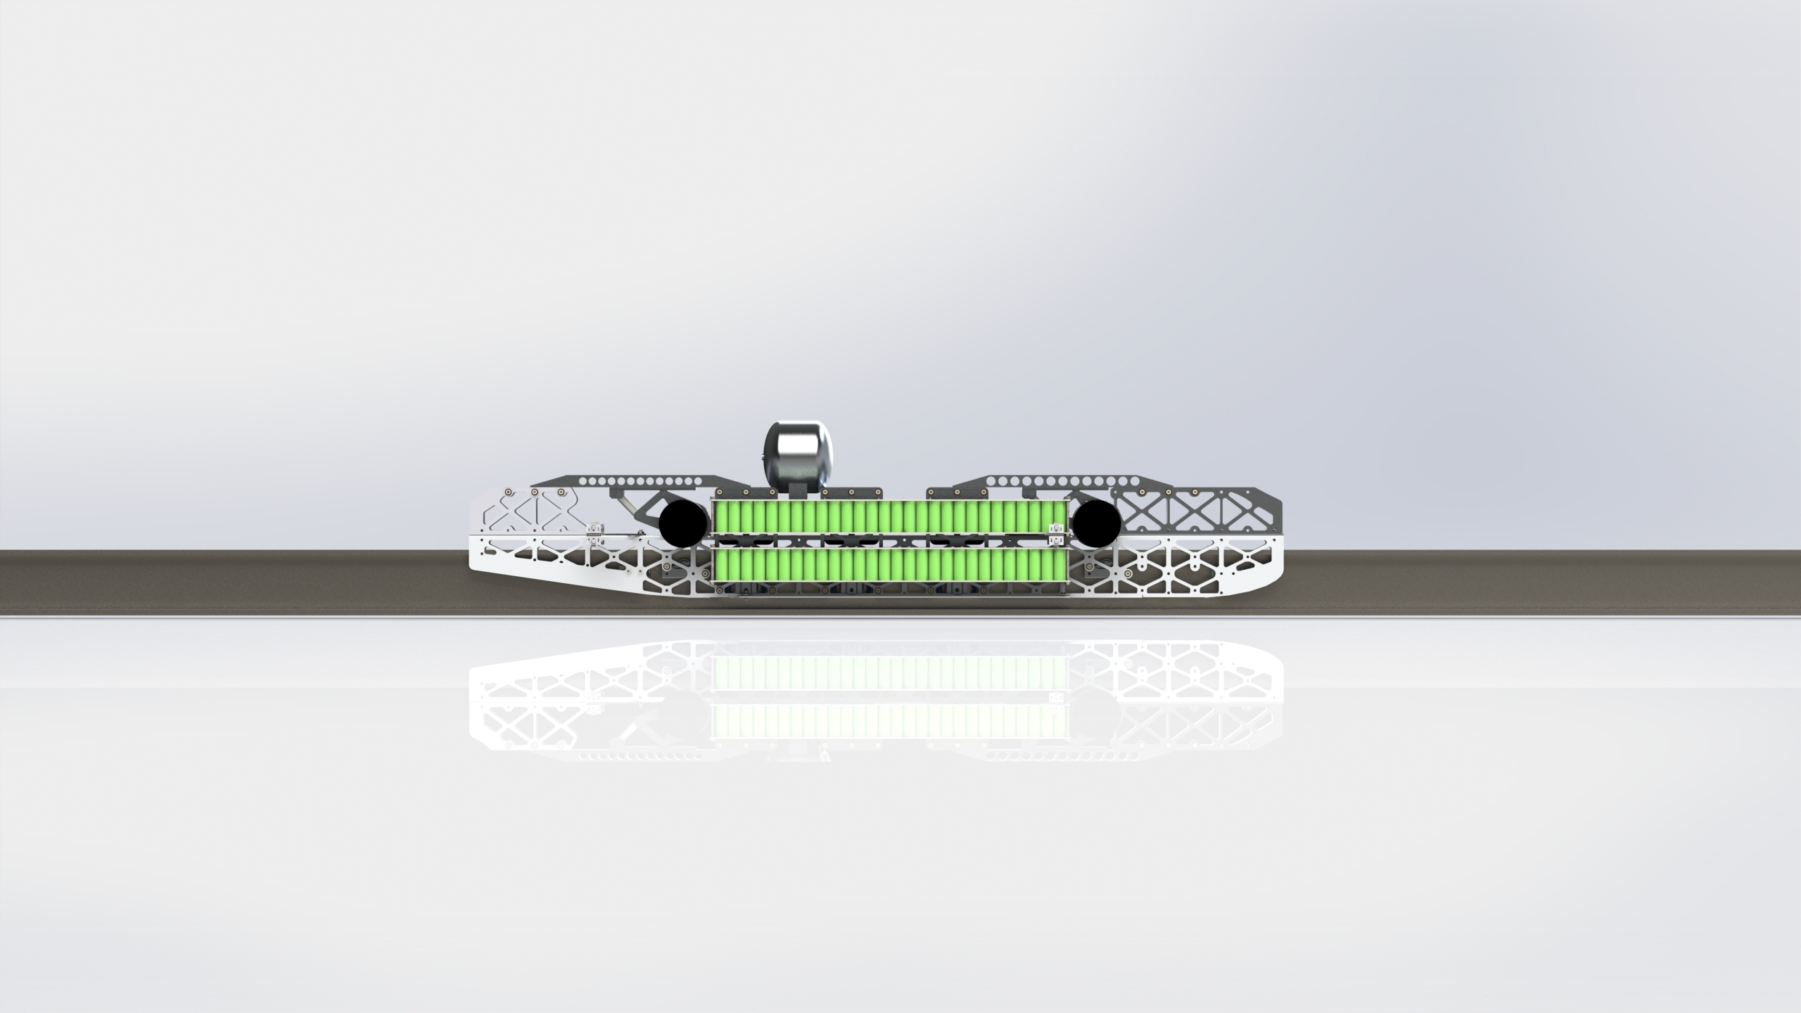
POD Overview

Slide 7
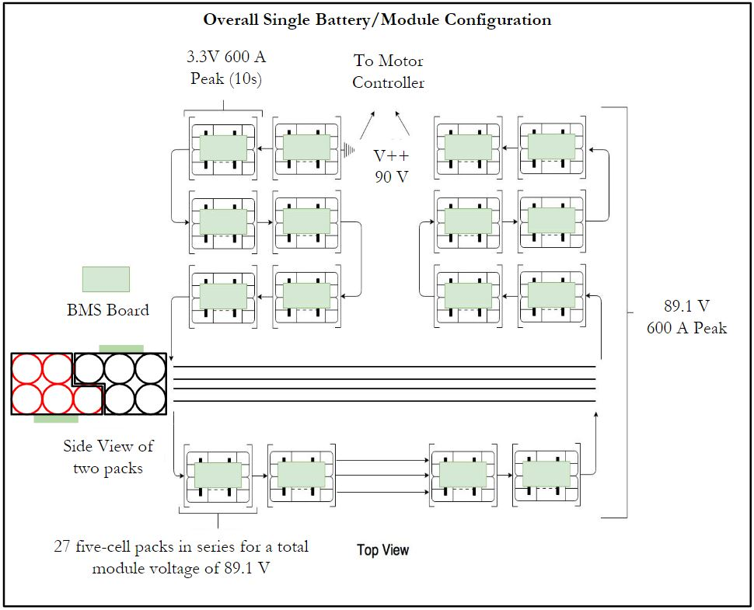
Power Systems: Overview
High Power Battery
540 A123 26650 Lithium Ion Cylindrical Cells (27S5P)
Number of Battery Cells Per Module: 135
Number of Battery Modules: 4 (one per motor)
Max Burst Power Capacity Per Module: 53.5 kW
Continuous Power Per Module: 31.2 kW
Total voltage Per Module: 89.1 V
Total capacity Per Module: 12.5 Ah
Total stored energy Per Module: 4.01 MJ (1.11 kWh)
Single Module Configuration: 27 packs in series. Packs interlaced in 'L-shaped" configuration, as shown in Figure.
Single battery module dimensions: .73 m x .0650 m x .078 m
Low Power Battery
12 V HR9-12 BB Lead Acid Battery
Total voltage: 12 V
Total capacity: 8 Ah
Total stored energy: 96 kJ
Overall battery dimension: .1588 m x .0650 m x .1001 m
Elithion Battery Management System (BMS)
Voltage, current, and temperature monitoring
Passive control over the battery contactors
Total Subsystem Mass: ~42 kg
Notes:
Design summary
▪ Concise high level summary of subsystem design
o Design rationale
▪ What are you considering and how is it factoring into your design?
o Testing & Validation
▪ Plan of how this subsystem will be tested and its functionality will
be validated

Slide 8
Power Systems: consumption
High-Power Consumption Specifications
Peak Battery Output | 53.46 kW
Peak Motor Power | 23.00 kW
Peak Output Mechanical Power | 22.31 kW
Peak Motor DC Power Input | 23.47 kW
Actual Peak Battery Output (Ignoring Losses) | 27.62 kW
Motor Power Factor | 0.8198
Motor Efficiency | 0.98
Drive Efficiency | 0.97
Peak Motor Voltage | 90 V_{DC}
Peak Motor Current | 256 A_{DC}
Low-Power Power Requirements
Component | Number | Power (W)
IMU | 1 | 0.22
Retro-reflective sensor | 2 | 0.3
Rotary Encoder on flywheel​ | 12 | 0.3
Laser distance sensor | 1 | 1.3
Pressure gauges​ | 4 | 80
Battery Monitoring System | 1 | 1.8
IR Thermometer CSmicro | 3 | 0.2
Contact Amtherm thermistors | 3 | 0.125
Vibration Sensors | 2 | 0.18
Wireless Sensor Module | 1 | 0.495
Brake caliper linear transducer | 4 | 0.84
Voltage Converter | 2 | 2.16

Slide 9
Power Systems: Rationale and testing & validation
Rationale
The cells will be grouped in packs of four which will be individually insulated by aluminized fabrics to reduce radiation heat transfer to other packs
Each battery pack will be laced to cooling plates which will use the same cooling system used by the TP motors
Although the battery can theoretically deliver most of the peak power requirement with only 2 cells in parallel, 5 cells are currently being considered to limit current discharge per cell and subsequently to avoid overheating of the battery.
The number of cells in parallel is subject to change after discharge testing of the cells is conducted
Testing and Validation
All tests will be performed in both ambient conditions and in a vacuum environment
Impact Test: Dropping various weights from a certain height to test battery’s container strength
Short Circuit Test: Examining the cell behavior during a worst case scenario
Rapid Depressurization: To examine how the cell responds to a sudden change in pressure
Load Performance: Testing at nominal and maximum discharge to confirm true capacity and max temperature difference
Thermal Test: To assess thermal profile while loaded and viable cooling methods if needed

Slide 10
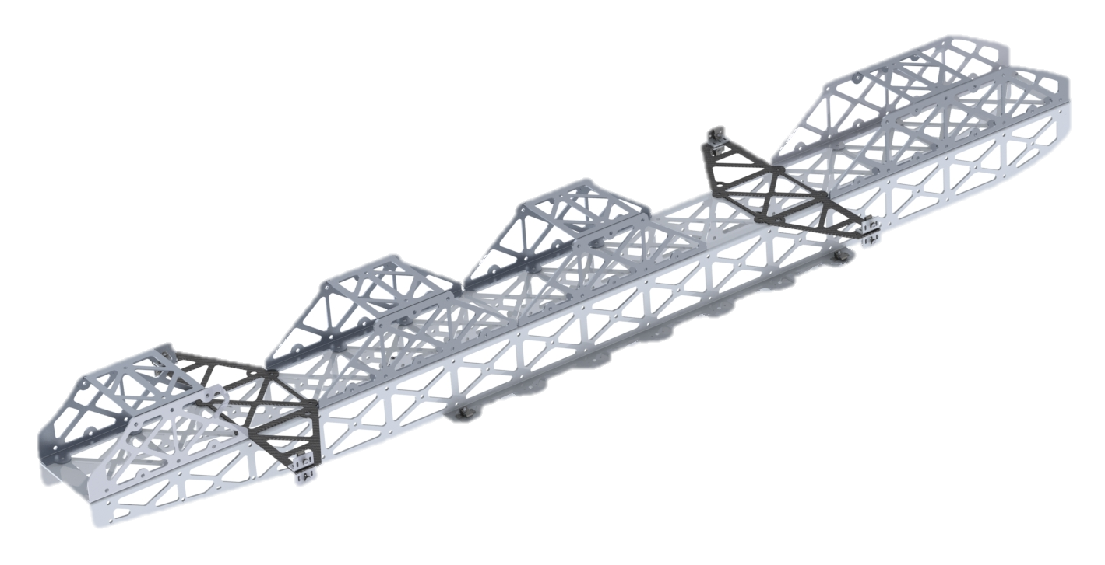
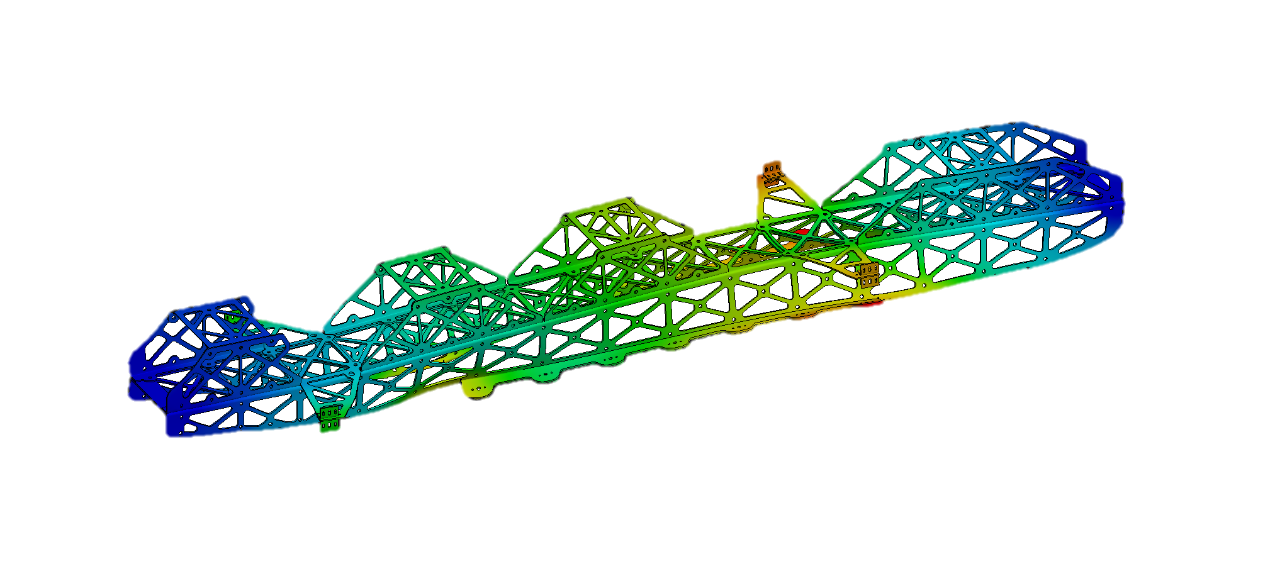
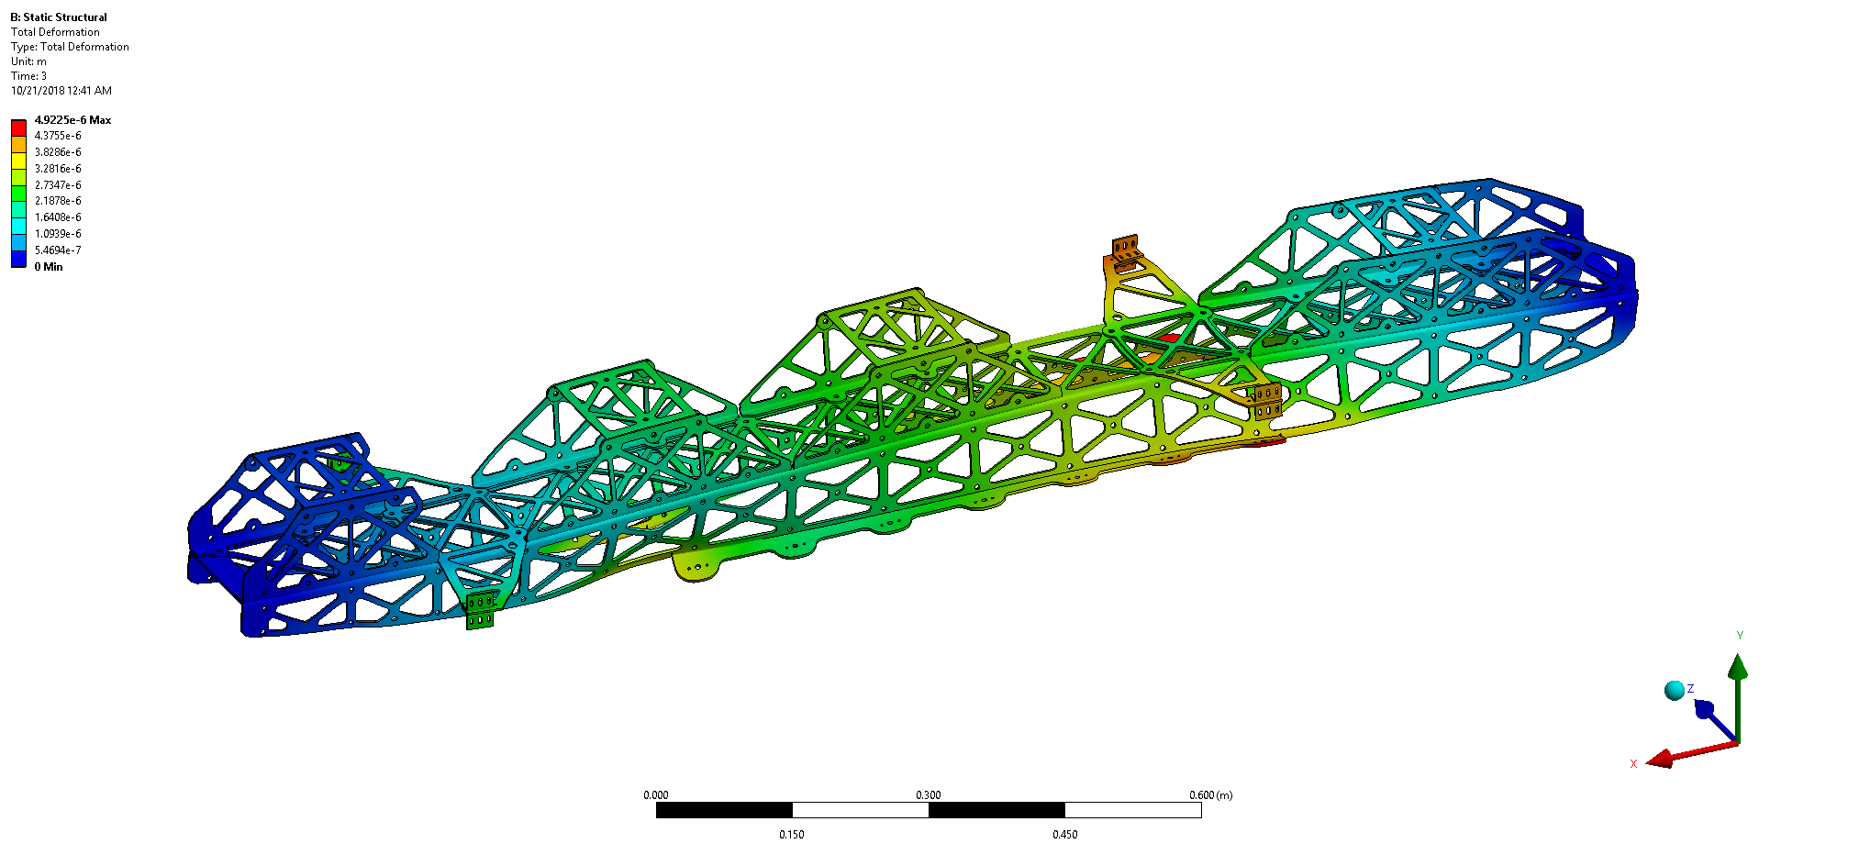
Structures Overview: Chassis
Design:
Acts as the primary structure of the vehicle
Provides mounting for aeroshell, propulsion, and braking systems
Analysis:
Brake loading study conducted in ANSYS Mechanical
5 g deceleration study total deformation shown
Safety factor of ~8 when braking
Manufacturing:
All parts are sheet metal or pre-layed up carbon fiber
Will be cut on a waterjet and then bent on a brake when necessary (metal parts only)

Slide 11
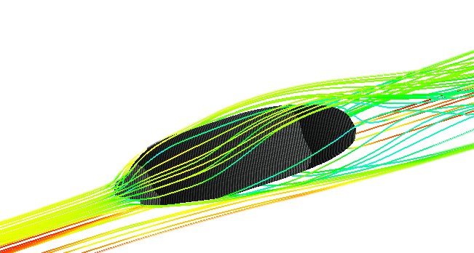
Structures Overview: Aeroshell
Design:
Prioritizes minimization of front cross-sectional area and mass
Edge geometry slightly flared to reduce vortex formation
Aerodynamic Analysis:
Density-based computational fluid dynamics study performed
Accounts for compressibility effects
500,000 mesh element viscous Spalart-Allmaras turbulence model accounts for possible flow separation
Manufacturing:
Wet carbon fiber layup with 4 layers of 2x2 twill
MDF mold created on 3-axis CNC
Geometric Parameters | Value
Overall Length (m) | 1.7
Overall Width (m) | 0.38
Overall Height (m) | 0.38
Shell Thickness (mm) | 1.011
Cross Sectional Area (m²) | 0.0743
Aerodynamic Parameters | Value
Coefficient of Drag | 0.147
Coefficient of Lift | 0.0401
Tested Density (kg/m³) | 0.111
Tested Mach Number | 0.441
Tested Static Temp. (K) | 298

Slide 12
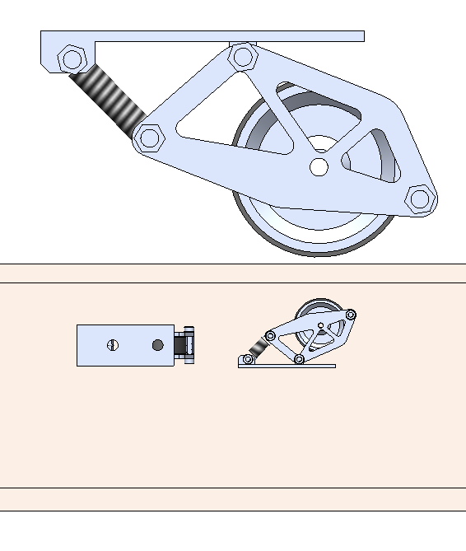
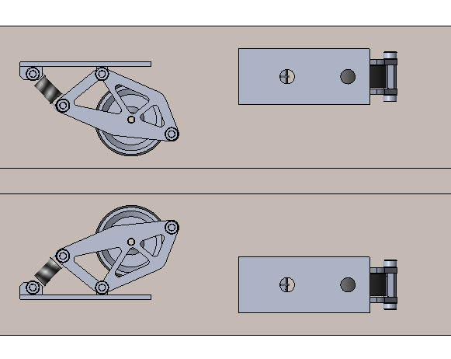
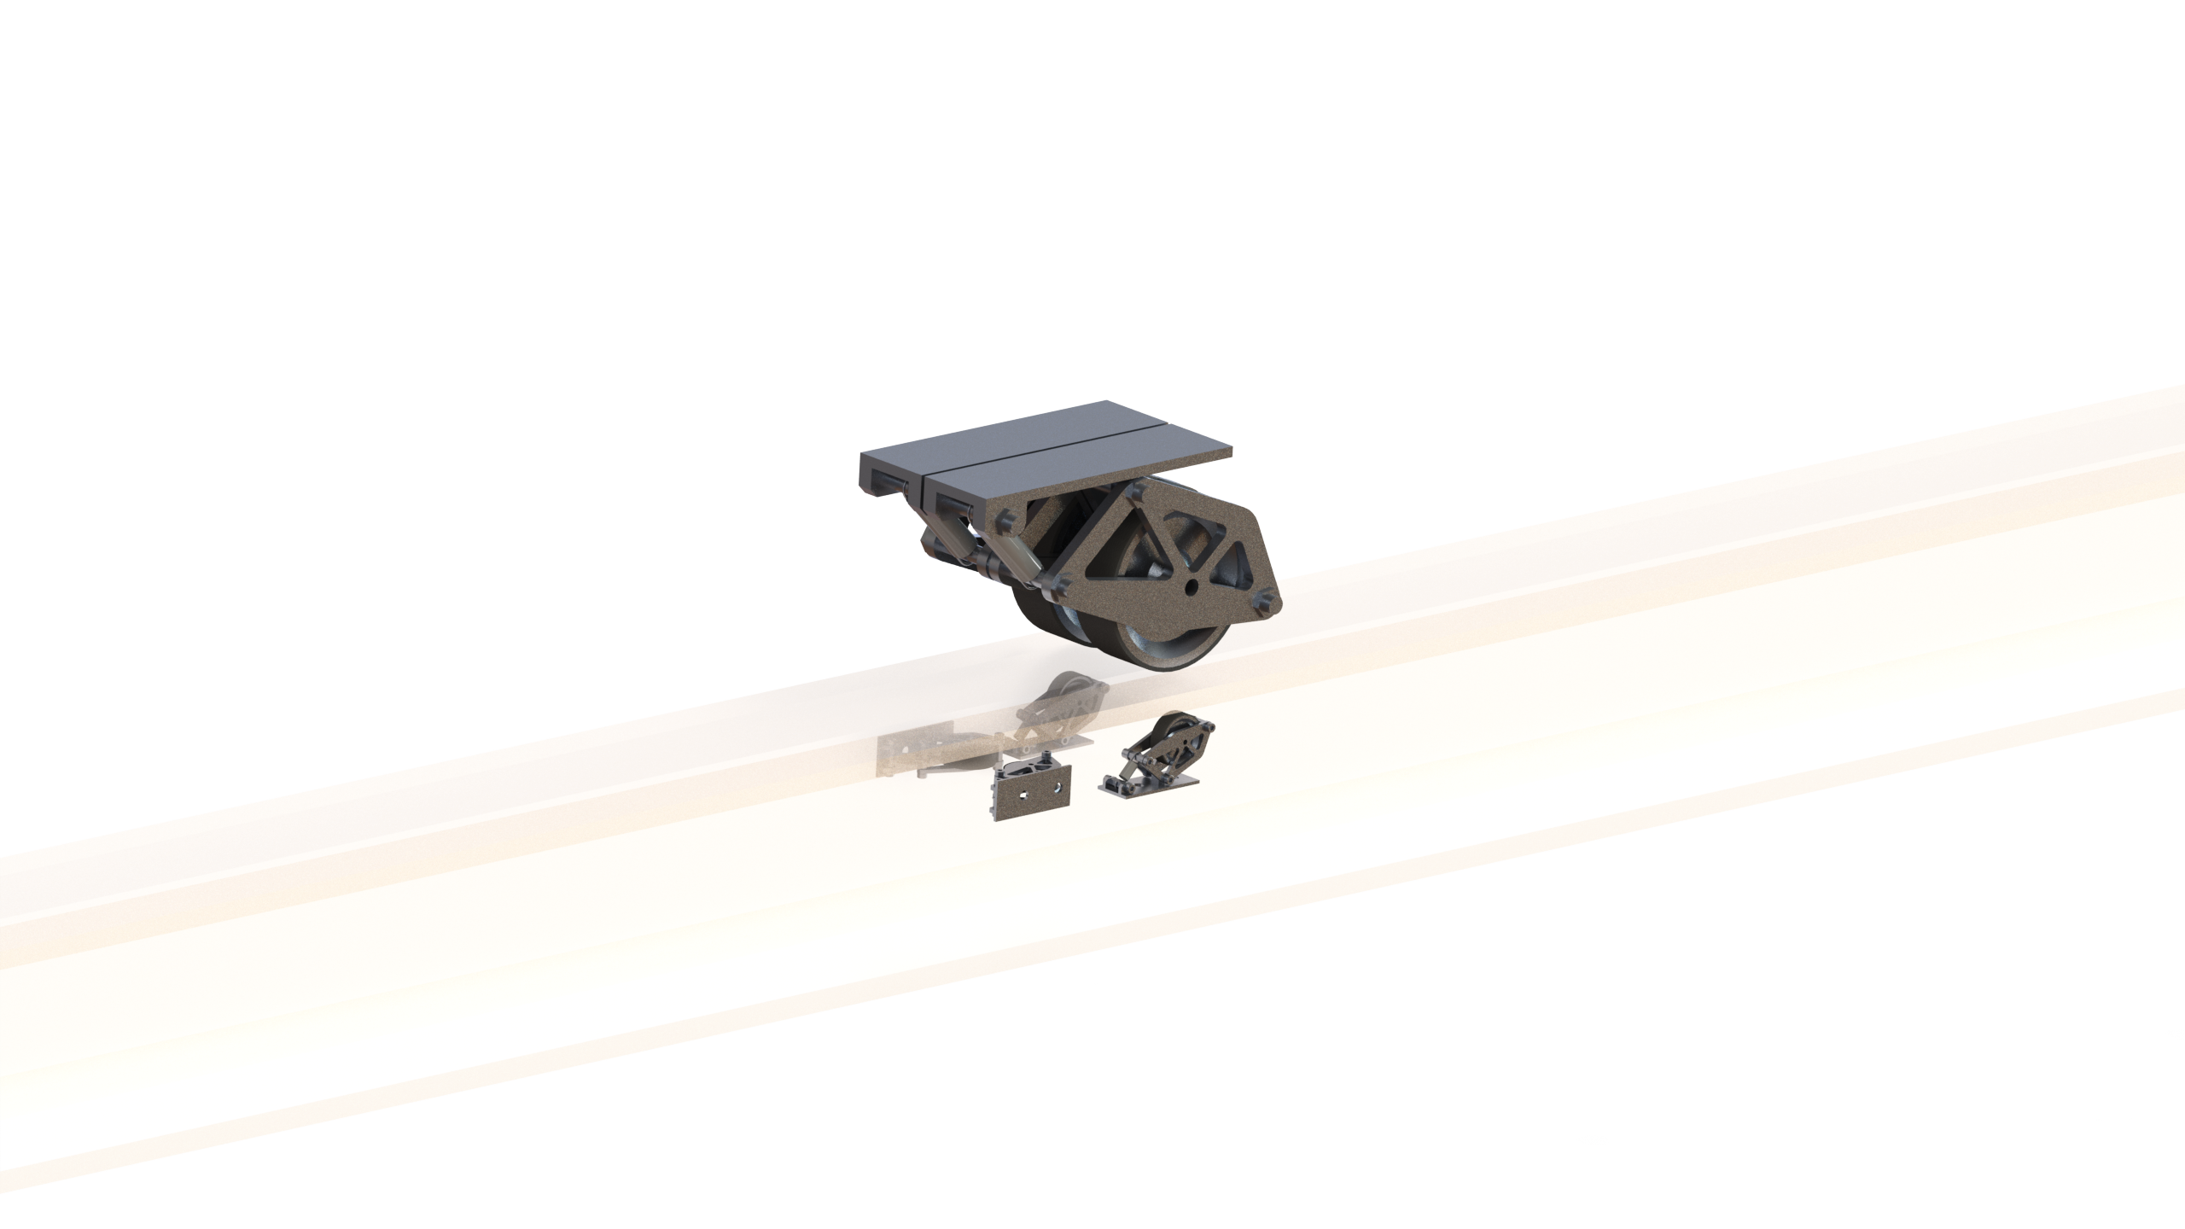
Stability
View from Side
Vertical Stability
Design
Rocker connected to a spring damper system and wheel
Stability system optimized for frequency range of pod
Rocker system underneath the track applies clamping force to prevent slippage on driven wheels
Lateral stability system helps stabilize pod along yaw axis
Testing:
Pod simulated with gaps on the track and alignment deflections
Physical testing will be performed by spinning an aluminum disk with a motor and applying stability wheels to the disk
Total Subsystem Mass: 2.5 kg
View from Below
Lateral Stability
Notes:
- Design summary
▪ Concise high level summary of subsystem design
o Design rationale
▪ What are you considering and how is it factoring into your design?
o Testing & Validation
▪ Plan of how this subsystem will be tested and its functionality will
be validated

Slide 13
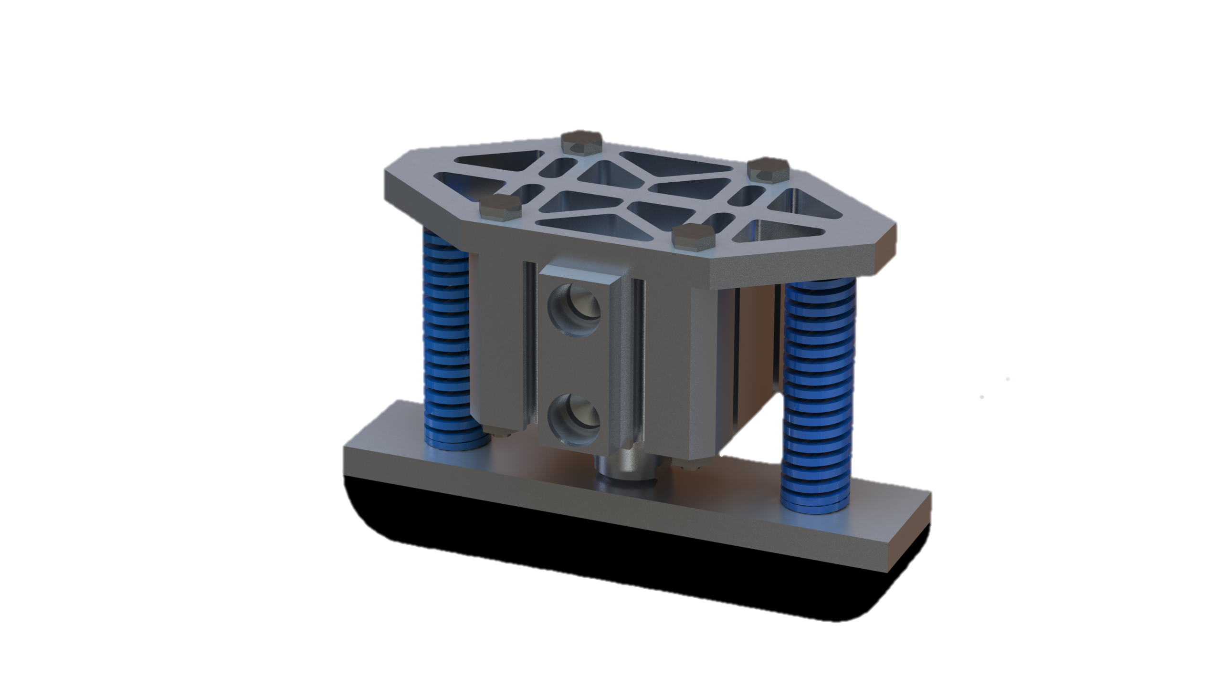
Braking and Pressure System
Brakes:
Friction Material: Non-Asbestos Organic
Coefficient of Friction: 0.55
Braking Force: 5000 N
Vehicle Deceleration: 5 g
Pneumatics:
Cylinder Bore: 38.1 mm
Operating Pressure: 0.921 MPa
Air Tank Volume: 1.90 L
Component | Mass (kg) | Quantity | Total Component Mass (kg)
Cylinder | 0.20 | 12 | 2.4
Spring | 0.09 | 24 | 2.18
Air Tank | 2.36 | 1 | 2.36
Brake Pad | 0.08 | 12 | 0.96
Total Subsystem Mass (kg) |  |  | 7.9
Notes:
Design summary
▪ Concise high level summary of subsystem design
o Design rationale
▪ What are you considering and how is it factoring into your design?
o Testing & Validation
▪ Plan of how this subsystem will be tested and its functionality will
be validated

Slide 14
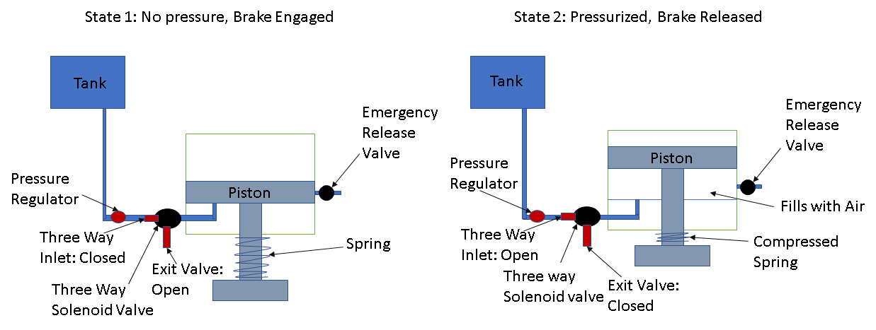
Braking and Pressure System
Pneumatics System Overview:
Air tank to be pressurized using an external compressor before loading the pod onto the track
Brakes are retracted when a 0.921 MPa is maintained
Brakes are fully engaged when brake cylinder is fully depressurized
An electronically-controlled valve regulates braking force by venting air to decrease cylinder pressure as needed
In case of failure, emergency valve will be opened, applying brakes to track
Notes:
Design summary
▪ Concise high level summary of subsystem design
o Design rationale
▪ What are you considering and how is it factoring into your design?
o Testing & Validation
▪ Plan of how this subsystem will be tested and its functionality will
be validated

Slide 15
Braking and Pressure System
Rationale:
Pneumatic spring applied brakes allows for a fail-safe in case of power failure. The cylinder needs to be pressurized to retract brakes, so if any failure occurs, the brakes will automatically be engaged after the cylinder is depressurized by an open valve. The braking force can also be adjusted by the amount of pressure present in the cylinders.
12 brakes were chosen so that the pod would have 6 brakes on the top of the rail and 6 brakes on the bottom of the rail to provide braking force that is symmetric. 12 brakes are needed to keep the pressure requirements at a reasonable level and at a size suitable for the track and chassis.
A non-asbestos organic friction material was chosen to avoid damaging the track when braking. The leading edge of the brake pads will be rounded off to better handle surface deviations on the track.
The entire braking system has been designed with minimal custom-made parts to maximize ease of manufacture.
Testing and Validation Plans:
A test rig will be constructed that will spin an aluminum flywheel up to a specified speed, at which point a brake situated on top of the disk will apply a braking force until the disk comes to a stop
This test rig will provide experimental data regarding wear rate, heating, coefficient of friction, and braking force as well as allow us to practically test electronic braking controls. Testing will be conducted in an ambient and low-pressure environment.
Notes:
Design summary
▪ Concise high level summary of subsystem design
o Design rationale
▪ What are you considering and how is it factoring into your design?
o Testing & Validation
▪ Plan of how this subsystem will be tested and its functionality will
be validated

Slide 16
Navigation AND CONTROL: SUMMARY
State | Condition/Transitions | High Power | Throttle | Brakes | Low Power
OFF |  | OFF | 0% | 100% | OFF
LOAD/UNLOAD | (“GO” is pressed) | OFF | 0% | 0% | ON
SAFE TO APPROACH | ("LOADED" is pressed) | ON | 0% | 100% | ON
READY TO LAUNCH | Input for Throttle | ON | 0% | 0% | ON
LAUNCHING | ("START" is pressed) | ON | INPUT% | 0% | ON
 | //runs until velocity x is achieved or if desired distance is reached.
BRAKING | (pod at y distance before end) | ON | 0% | 100% | ON
 | //runs until velocity = 0
CRAWLING | (pod stopped early) | ON | 20% | 0% | ON
 | //runs until finish line is reached
EMERGENCY BRAKE | if (Temp on a circuit exceeds <a temp> | ON | 0% | 100% | ON
 | OR Temp on battery exceeds <b temp>
 | OR Temp on motor exceeds <c temp>
 | OR Vibration exceeds <d amplitude>
 | OR Network Disconnect)
 | then FAULT_DETECTED = true;
Fiducial Sensors Inertial Measurement Unit Retroreflective Sensors Rotary Encoders Motor Encoders Laser distance sensor

Slide 17
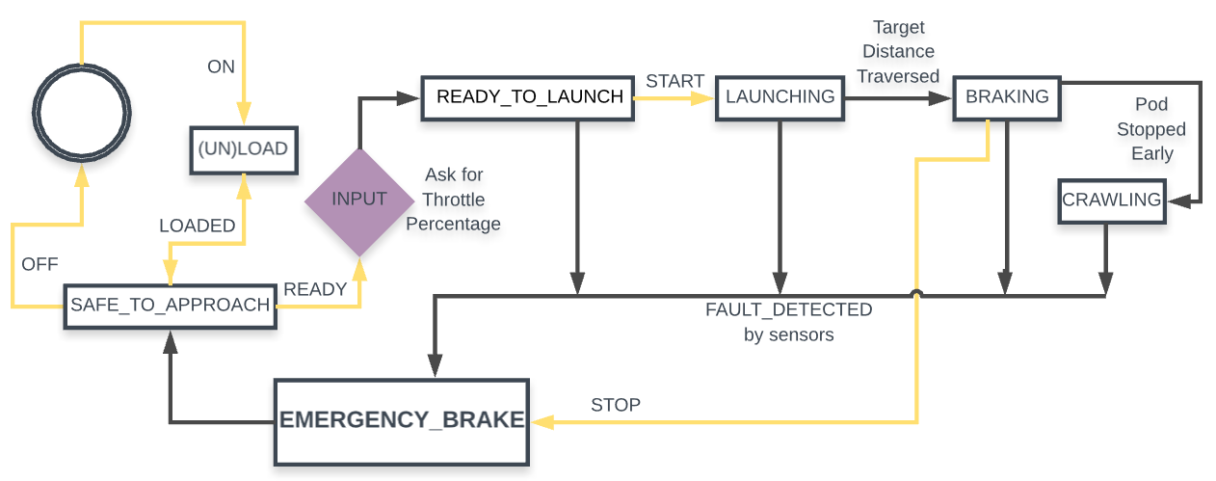
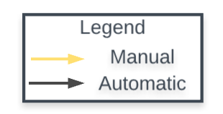
Navigation AND CONTROL: Control State Diagram
Notes:
Explain the loading and unloading stages of the pod trial, and why it isn’t a separate state.
Design summary
▪ Concise high level summary of subsystem design
o Design rationale
▪ What are you considering and how is it factoring into your design?
o Testing & Validation
▪ Plan of how this subsystem will be tested and its functionality will
be validated
<slide 1> high level summary of subsystem design (state diagram + fiducial system + all sensors essential to movement)
<slide 1.5> ^
<slide 2> rationale: why we did that
<slide 3> testing + validation
https://www.lucidchart.com/invitations/accept/5467e289-114e-45da-94af-fd7a03f94cfe

Slide 18
Navigation and control: rationale
Sensor(s) | Data | Comments
Inertial Measurement Unit | Acceleration | Two, located at front and back of pod to minimize error by comparing two data sets.
 |  | Acceleration can also be used to calculate velocity
 |  | Consists of Gyroscope and Accelerometer
Rotary Encoder on flywheel | Velocity | One on the non-powered flywheel at center of mass to calculate velocity. Compare data with Motor Encoder to get a small interval in which true velocity of the pod lies, due to slippage between the track and wheels.
Motor Encoder | Velocity | On each direct drive motor system for 4x independent data collection.
Retroreflective sensor | Distance | Two, on sides of pod (will function as "eyes" of pod).
 |  | 3 kHz+ sampling rate to account for high speed at which the pod moves, and taking into account thickness of retroreflective tape to ensure in the worst case scenario, at least one data collection point would cover each strip
Laser distance sensor | Distance | To determine distance from pod to end of the tube, within 100 ft.
Temperature sensors | Temperature | Infrared Sensor: ThermoMETER CSmicro
 |  | Contact Sensor: Amtherm Thermistors
Power consumption monitor | Power for Main Power System | Shunt for Main Power System
Vibration Sensors | Gyroscope fluctuations | Changes in the Gyroscope correspond to changes in the Amplitude of Vibration, which measures pod stability.
Pressure Transducer | Air Pressure | Monitors pressure in air tanks and brakes.

Slide 19
Navigation and control: Testing & validation
Sensor Testing
Individual sensor testing and calibration out of the box to ensure components meet requirements
Simulated environment testing for retroreflective sensors, rotary encoders, and IMU to ensure they operate reliably at pod’s max speed
All tests performed in both ambient conditions and in a vacuum environment
Control Testing
Ensure proper state transitions with simulated and real sensor data
Simulated component failures
PCB/controller reliability testing in vacuum environment and at expected running temperatures

Slide 20
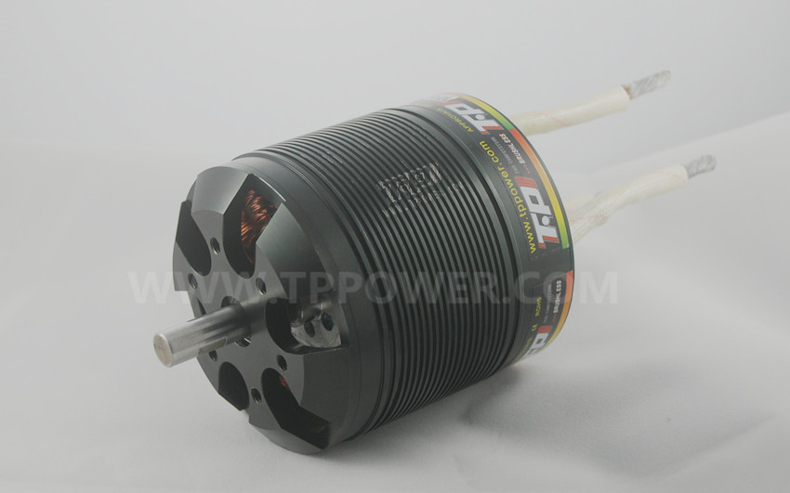
Propulsion System
Motor: TP Power TP-100 X 4 (Direct Drive)
Power (Continuous/Peak): 12kW/23kW
Max RPM: 25000
Torque: 8.2Nm
Acceleration: 0.71 g
Voltage: 90V
Current: 256A
Motor Controller: Flier 22S 350A ESC
Wheels:
Diameter: 10.24 cm
Material: Aluminum Rim, .26 cm polyurethane lining
Coefficient of Friction: 0.76
Component | Mass (kg) | Quantity | Total Component Mass (kg)
Motor | 2.93 | 4 | 11.7
Wheel | 0.46 | 4 | 1.8
Cooling System | 11 | 1 | 11
Motor Controller | 0.54 | 4 | 2.2
Total Subsystem Mass (kg) |  |  | 26.7
Notes:
Design summary
▪ Concise high level summary of subsystem design
o Design rationale
▪ What are you considering and how is it factoring into your design?
o Testing & Validation
▪ Plan of how this subsystem will be tested and its functionality will
be validated

Slide 21
Propulsion System
Rationale:
Direct drive enables us to reduce mass from belt drives, improve power transmission efficiency, simplify design, and reduce wheel size.
Direct drive also increases manufacturability since a complex belt drive system will not be necessary.
The TP 100 Motor was chosen because of its high rpm, high power output, low mass, and optimum max current/voltage.
Testing and Validation Plans:
To determine the viability of braking using the motors, a rheostatic braking test rig will be constructed using a motor and an aluminum flywheel. The wheel will be spun by the motor up to the max motor rpm, and then the deceleration of the flywheel will be measured while the motor is unpowered, allowing braking force to be calculated versus velocity.
To test heating of motors in a low-pressure environment, we will attach a thermocouple to the motor and run it at max power in different pressures for 30 seconds to model a heat vs. pressure curve.
Notes:
Design summary
▪ Concise high level summary of subsystem design
o Design rationale
▪ What are you considering and how is it factoring into your design?
o Testing & Validation
▪ Plan of how this subsystem will be tested and its functionality will
be validated

Slide 22
Cooling System
Batteries
System Overview:
Each TP 100 motor includes a water-cooling jacket through which water will be pumped
Using four smaller motors rather than one large motor reduces the heat produced per motor, thereby reducing the risk of overheating
Batteries and other electronics will also be water-cooled via a chilling plate
Pump Flow Rate: 12 L/min
Electronics
Motor
Motor
Motor
Motor
Pump
Radiator
Notes:
Design summary
▪ Concise high level summary of subsystem design
o Design rationale
▪ What are you considering and how is it factoring into your design?
o Testing & Validation
▪ Plan of how this subsystem will be tested and its functionality will
be validated

Slide 23
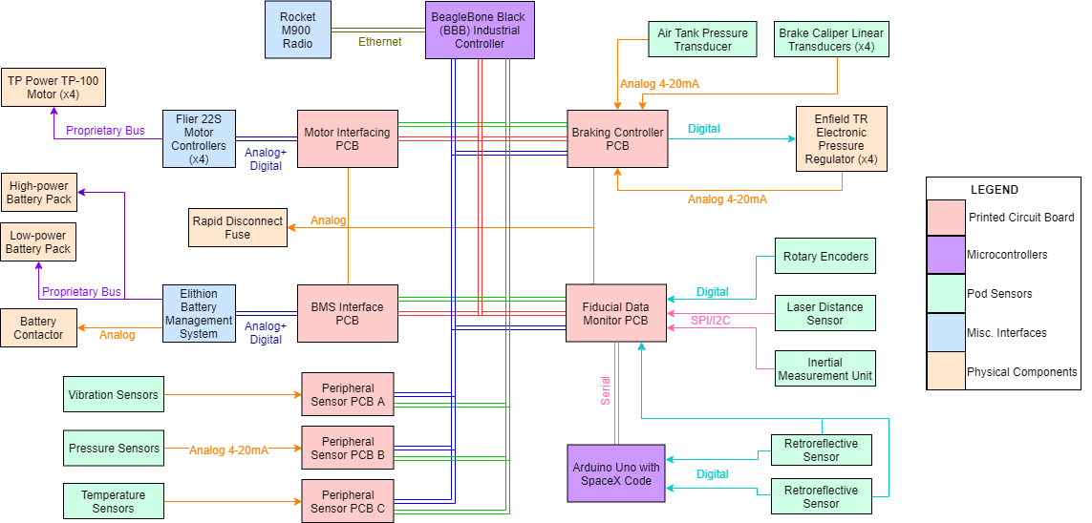
Electronics Systems

Slide 24
Electronics system: rationale
Motor Interfacing PCB
Relays critical control commands to motor controllers, feeds back motor encoder data to other PCBs on CAN bus.
Braking Controller PCB
Forwards pressure setpoints to pressure regulators and monitors regulator stability for a fault state.
Monitors air tank pressure for safety, linear transducers for brake operation verification.
Fiducial Data Monitor PCB
Reads in from retroreflective sensors on digital interrupts to measure total distance travelled using tape.
Ensures redundancy with rotary encoder data for worst-case distance, IMU for instant acceleration and velocity.
Equipped with laser distance sensor to ensure good distance accuracy for final 100 feet of run.
Battery Monitoring Interface PCB
Interfaces with Elithion battery management system to read battery pack current, voltage and temperature data.
Can effect shutdown if power loss is imminent, batteries are overdrawn, or thermal runaway is detected.
Peripheral Sensor PCBs
Localized PCBs at sensor points-of-use, used to relay non-critical sensor information on CAN bus.
Sensor information can be used to change drivetrain processes if data collected is outside safe thresholds.

Slide 25
Hazardous Systems
Pressure Systems:
Max Pressure Rating: 1.034 MPa
Planned Operating Pressure: 0.921 MPa
Stored Energy in Air Tank: 12.2 kJ
Emergency release valve will ensure pressure in system does not exceed 1.034 MPa
Batteries:
High Power Circuit Stored Energy: 17.84 MJ
Low Power Circuit Stored Energy: 96 kJ
High power circuit managed by an Elithion Battery Management System
Notes:
o Magnets
o Pressure systems
o High Voltage batteries

Slide 26
Anticipated Challenges
Hardware-Firmware Compatibility: Using a variety of custom and off-the-shelf hardware and firmware will create a system that is complex to debug
Integration testing will be done along the way to ensure each electronic subsystem works in the overall pod before completing the next subsystem’s electronics
Stability: Ensuring pod stability during braking phase will be difficult due to the high forces involved
Data acquired through rigorous simulation will be combined with physical data from the vehicle dynamics test rig to confirm that the pod will brake smoothly
Structural Analysis: Structural analysis will require significant computing resources
An analysis specific desktop computer is being sponsored by the School of Aerospace Engineering
Thermal Testing: Due to the low-pressure environment of the track, the cooling system will need to be thoroughly validated to ensure that no system overheats during the run
Vehicle components will be tested at low pressures to ensure that temperature increases are within allowable limits

Slide 27
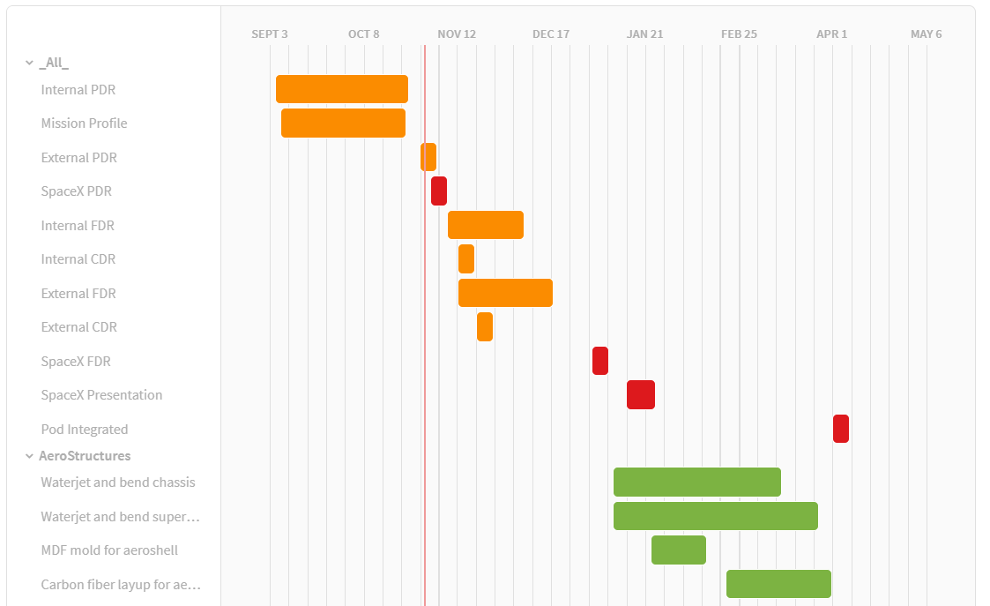
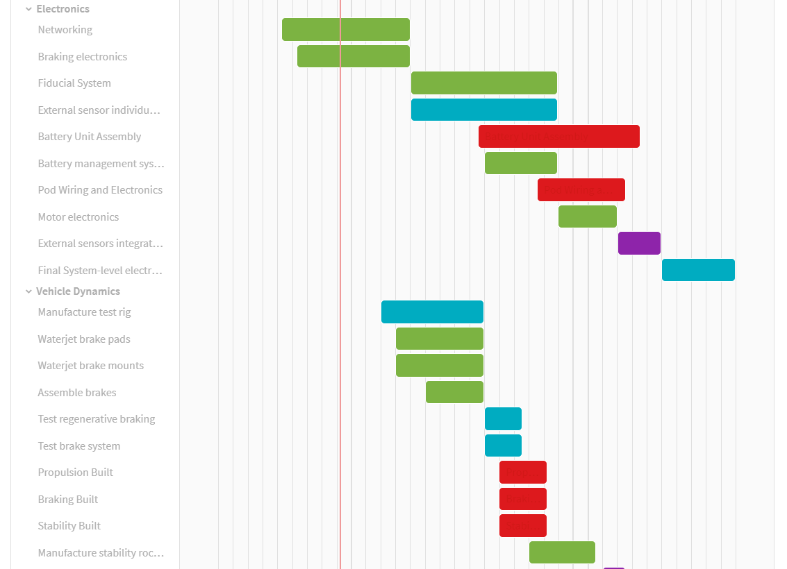
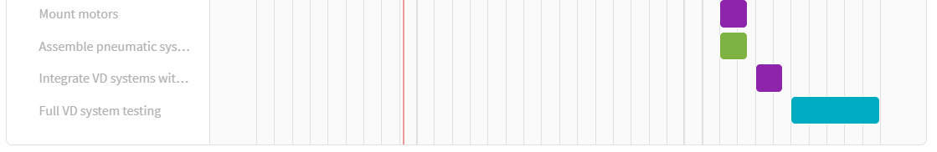
Design, Build, Test Timeline: Vehicle Dynamics and Electronics

Slide 28
Design, Build, Test Timeline: AeroStructures

Slide 29
Funding Plan and Timeline
Overall budget for full-vehicle manufacture/integration: Approximately $27,000
Sources:
Georgia Tech Student Government Association (SGA): $10,000-$15,000 expected
Corporate Sponsors: $15,000-$20,000 expected
GT School of Aerospace Engineering: Ancillary Support (lab space, compute resources)
Phase | Timeline | Description (of components to be procured) | Funds Allocated | Source(s)
Phase 1 | 8/2018-9/2018 | Initial electronics and communications products Propulsion system and motors | $4,000 | SGA
Phase 2 | 10/2018-11/2018 | Metal and composite materials for structures Circuit boards and pressure system electronics | $8,000 | SGA
Phase 3 | 12/2018-7/2019 | Dynamical and fluid system components Power system, controllers, and final electronics assemblies Full vehicle integration | $15,000 | SGA Corporate Sponsors

